Slide 1

Forecasting Regional Electrical Loading Using Boosted Decision Tree Regression
SMART Power

Slide 2

PROBLEM STATEMENT
Ontario utilities should improve the power demand prediction accuracy and reliability by employing a more robust short term forecasting model.
The current methodology uses historical data such as temperature and customer loads but has difficulty estimating for fluctuations resulting from holidays, extreme weather or other force majeures. Inaccuracies in forecasts can cause surplus generation, asset investment risk and additional fees to the downstream customer.
By deploying a Machine Learning algorithm to the areas of load forecasting, it is possible to overcome the limitations of the previous method.

Slide 3
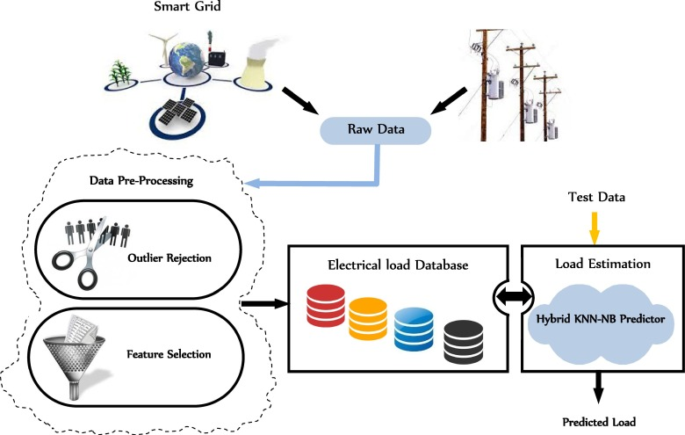
DESCRIPTION OF SOLUTION
How will it improve forecasting?
Using an artificial neural network model can create a matrix of inputs from real historical data to train from. This implementation uses past electrical loads from Toronto, Ottawa and the Bruce Peninsula, to capture the customer trends from 2013-2020. The factors affecting electrical demand are primarily weather and time of day, causing the fluctuations seen in lighting or heating. The model will use hourly climate data {temperature, dew point, relative humidity, wind speed} specific to each region to better forecast customer load in short term forecasting. The neural network will train on 70% of the dataset and test on the remaining 30% to its proven accuracy and reliability. Its effectiveness can also be compared with the forecasted demand proved by corporations in Ontario such as the IESO and Local Distribution Companies.
What Makes it Achievable?
This is a feasible solution because it capitalizes on the large, sustainable, and reliable training dataset available for weather and past electrical demand that is specific to each region. It is an increasingly accurate predictor for Short Term Load Forecasting due to the inherent ability of machine learning techniques to handle nonlinear functions due to their high degree of computational power, generating a robust solution. All data is sourced from government websites, carrying high reliability and can be expected to continue outputting statistics in the immediate future.
What Makes it Unique?
This solution includes large, medium and small load profiles to scale the model to unique grids sizes. This makes it translatable for use in future smart grids, where arbitrary regions can temporarily become disconnected from the main electrical grid and must rely on distributed generation.
The climate dataset used includes a variety of factors that have been linked to affect customer demand and have been neglected in previous model iterations due to complexity of data size.

Slide 4



TARGET
Who’s your target market?
The target market for this type of demand forecasting is targeted to companies in the electrical utility industry in Ontario, but can be scaled to other regions with growth. The primary candidate would be the crown corporate, IESO, who is responsible for operating the electricity market for Ontario. Secondary targets are licensed energy retailers in the natural gas, renewables and nuclear power industries. This data would be marketable because load forecasts provide insight for workforce hiring, equipment maintenance scheduling and to reduce overgeneration.
What’s the size of the target market?
In the past, system operators have benefited from $2 – 4 million in immediate cost savings from improving their electrical demand forecasting. The cascading effect from integration cost savings and improved asset management could add $100 – 200k to the market size.
An estimated initial market size could be between $100k - $500k with the introduction of the IESO as the primary customer. This size is expected to grow with the addition of forecasting new regions as well as extending the service to Licensed Active Retailer customer base.
This particular stream is relatively small, as the global AI market is expected to reach $7.78B by 2024.

Slide 5
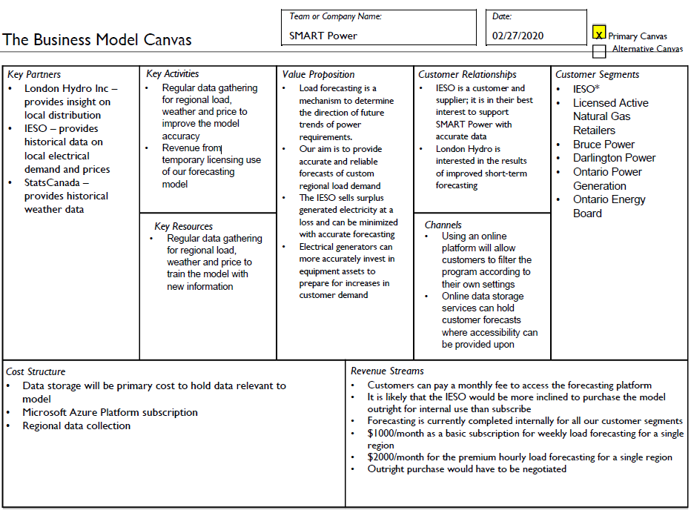
BUSINESS MODEL

Slide 6

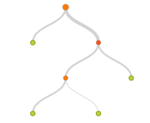


SOLUTION’S ARCHITECTURE
Dataset
Eliminate Missing Values
Normalize Data
The solution can be implemented into a web-based platform, where users may access it
The model uses the shown architecture with the following sample data needed:
This information is provided hourly, for free, on the IESO and StatsCanada websites which make it a sustainable source for this solution.
The current model uses a 99 Boost Decision Tree Regression to fit the residual of the nodes that precede it, thus improving accuracy with some small risk of less coverage
The solution is built in Microsoft Azure Machine Learning Studios for concept generation and will be cloned in Python to use its open source libraries
Split Data
Train Data
[Date, Hour, Temperature, Dew Point, Relative Humidity, Wind Speed, Sample_Region, Forecast Difference, Price]
Boosted Decision Tree Regression
Score Model
Evaluate

Slide 7
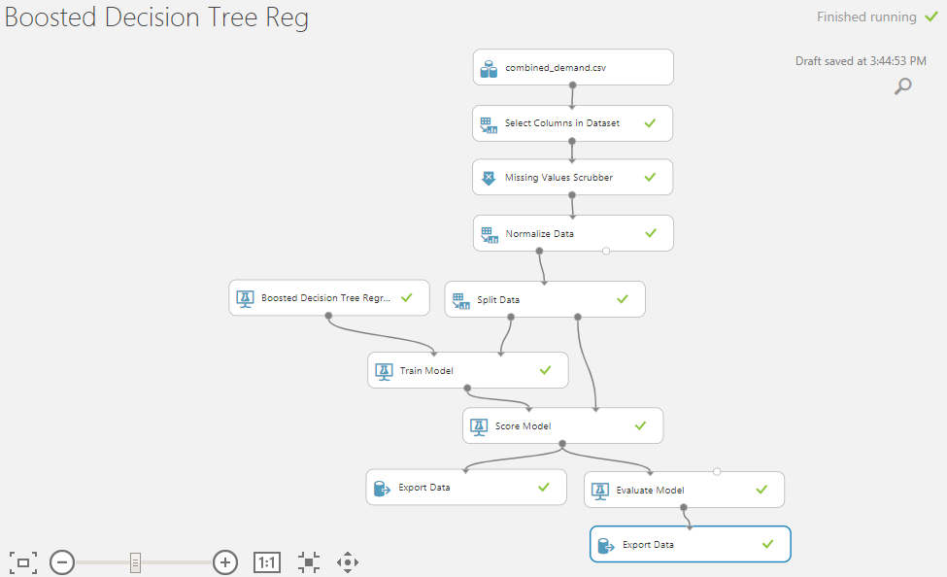
Prototype Results
An initial prototype of the Boosted Decision Tree Regression has been applied for Toronto, Ottawa and Bruce regional datasets, using Microsoft Azure Machine Learning Studios:
Toronto Dataset Mean Absolute Percentage Error: 4.86%
Ottawa Dataset Mean Absolute Percentage Error: 7.06%
Bruce Dataset Mean Absolute Percentage Error: 28.44%
Ottawa and Bruce models have higher error due to significantly more null values in the dataset that are not being scrubbed correctly.

Slide 8
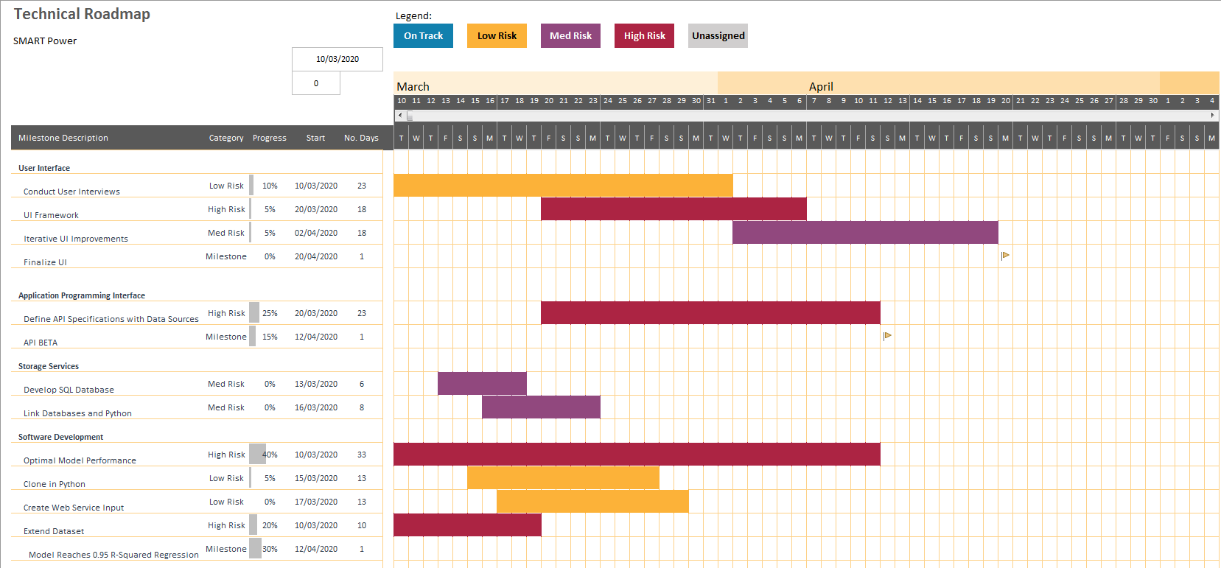
Technical Roadmap

Slide 9
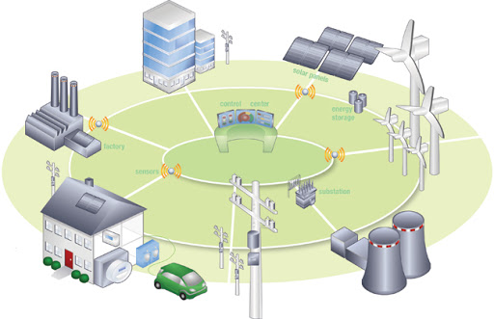
BENEFITS OF THE APPROACH
Economic Benefits
Optimal regional power generation scheduling
Reduce surplus selling at loss leader
Improve asset investment planning
Downstream savings passed onto energy consumers
Social Benefits
Better forecasting can lead to more home-based distributed generation
Preparation for blackouts due to inadequate supply
May lead to more electric vehicle purchases
Emphasizes electric storage needs to accommodate load growth
Increased implementation of commercial SMART metering
Environmental Benefits
Reduces a surplus of electricity generation
Increased distributed generation from renewables

Slide 10




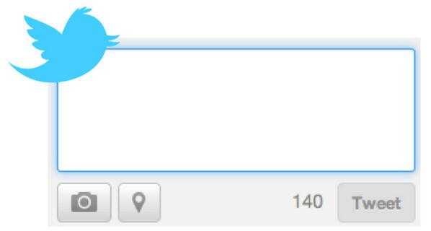
TEAM PRESENTATION
Adam
Dunn
23
Bachelor’s of Electrical Engineering
Dheeraj
Ghangas
23
Honour’s Bachelor of Business Administration
Nathen
Gay
23
Honour’s Bachelor of Technology – Software Development
@WesternU alumni, SMART tech advocate, looking to leverage analytics for consumers. I get my tan from the glare on my monitors.
@Laurier Alumni, passionate about tech,
finance, politics and cars. Looking to
make a positive impact in my short time
on this planet (eventually Mars).
Currently a student @SenecaCollege,
Interested in software development
Love to expand my knowledge in my
free time as well as play sports.

Slide 11
Appendix
https://climate.weather.gc.ca/index_e.html
http://reports.ieso.ca/
https://www.prnewswire.com/news-releases/global-ai-in-energy-market-to-reach-7-78-billion-by-2024--300984256.html
https://towardsdatascience.com/
K. B. Sahay, S. Sahu and P. Singh, "Short-term load forecasting of Toronto Canada by using different ANN algorithms," 2016 IEEE 6th International Conference on Power Systems (ICPS), New Delhi, 2016, pp. 1-6.
Mahmoud Abbasi Nokar, Farzad Tashtarian, Mohammad Hossein Yaghmaee Moghaddam, "Residential power consumption forecasting in the smart grid using ANFIS system", Computer and Knowledge Engineering (ICCKE) 2017 7th International Conference on, pp. 111-118, 2017.
Savita Pawar, B. F. Momin, "Smart electricity meter data analytics: A brief review", IEEE Region 10 Symposium (TENSYMP) 2017, pp. 1-5, 2017
Kishan Bhushan Sahay, Khushboo Singh, "Short-Term Price Forecasting by Using ANN Algorithms", Electrical Engineering Congress (iEECON) 2018 International, pp. 1-4, 2018.
S. Surender Reddy, "Bat algorithm-based back propagation approach for short-term load forecasting considering weather factors", Electrical Engineering, vol. 100, pp. 1297, 2018.
K. B. Sahay, N. Kumar and M. M. Tripathi, "Short-term load forecasting of Ontario Electricity Market by considering the effect of temperature," 2014 6th IEEE Power India International Conference (PIICON), Delhi, 2014, pp. 1-6.
https://www.relexsolutions.com/resources/measuring-forecast-accuracy/
https://www.eia.gov/outlooks/steo/report/electricity.php
https://www.sciencedirect.com/topics/engineering/energy-forecasting

